Slide 1

Connecting travelling scientists with schools and universities worldwide
Eugenia Covernton - 23/04/2020

Slide 2




Our idea: connecting scientists and schools
LeWiBo: a network of scientists and schools
Scientists tells us where they’re going,
we find a school
and coordinate the lecture!

Slide 3

COVID-19: challenges and opportunities
In 2020, most scientists didn’t travel and millions of schools were closed
LeWiBo turned most lectures into webinars and podcasts and organized online events!

Slide 4
EPSC: EuroPlanet Science Congress
Notes:
European Planetology Network (EuroPlaNet) – Started in 2006 and organizes workshops and events to identify science goals, develop synergies between space missions and ground-based observations and lay the foundations for a Virtual Planetary Observatory.

Slide 5

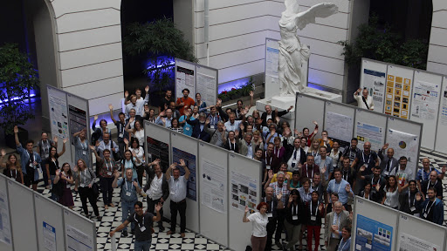

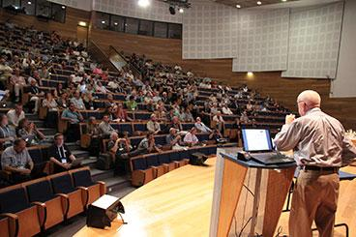
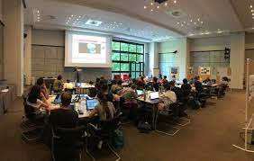
EPSC: EuroPlanet Science Congress
Started in 2006
Annual event ̴ 1000 people
Notes:
European Planetology Network (EuroPlaNet) – Started in 2006 and organizes workshops and events to identify science goals, develop synergies between space missions and ground-based observations and lay the foundations for a Virtual Planetary Observatory.

Slide 6
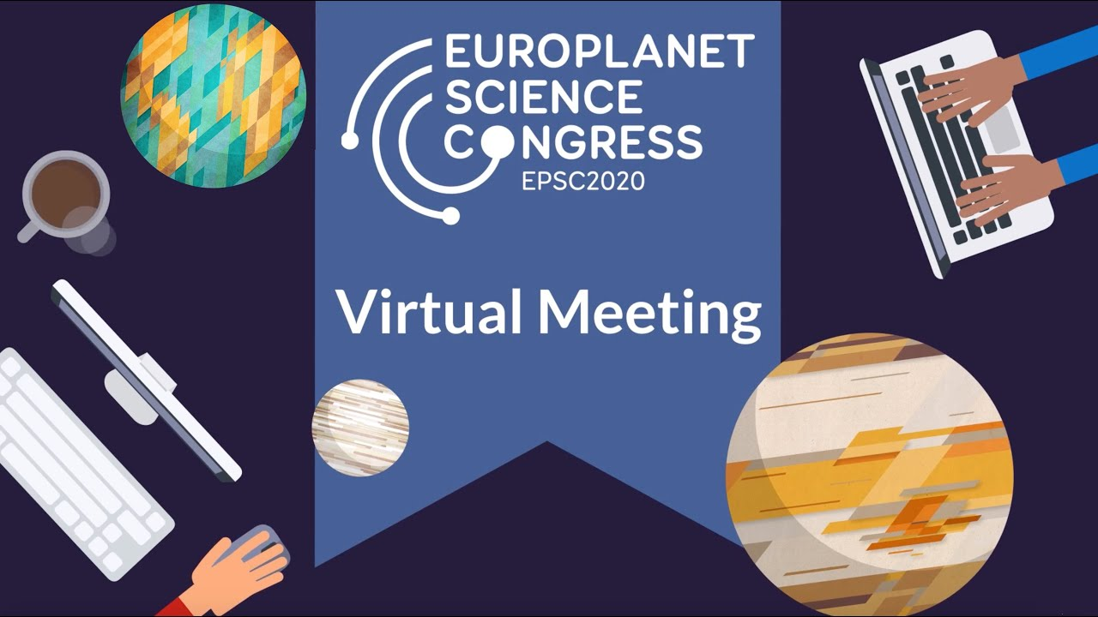
EPSC: EuroPlanet Science Congress
Started in 2006
Annual event ̴ 1000 people
In 2020, the event in Granada, Spain, had to be cancelled and EPSC2020 was held online
Notes:
European Planetology Network (EuroPlaNet) – Started in 2006 and organizes workshops and events to identify science goals, develop synergies between space missions and ground-based observations and lay the foundations for a Virtual Planetary Observatory.

Slide 7


Opening a scientific conference to schools

Slide 8
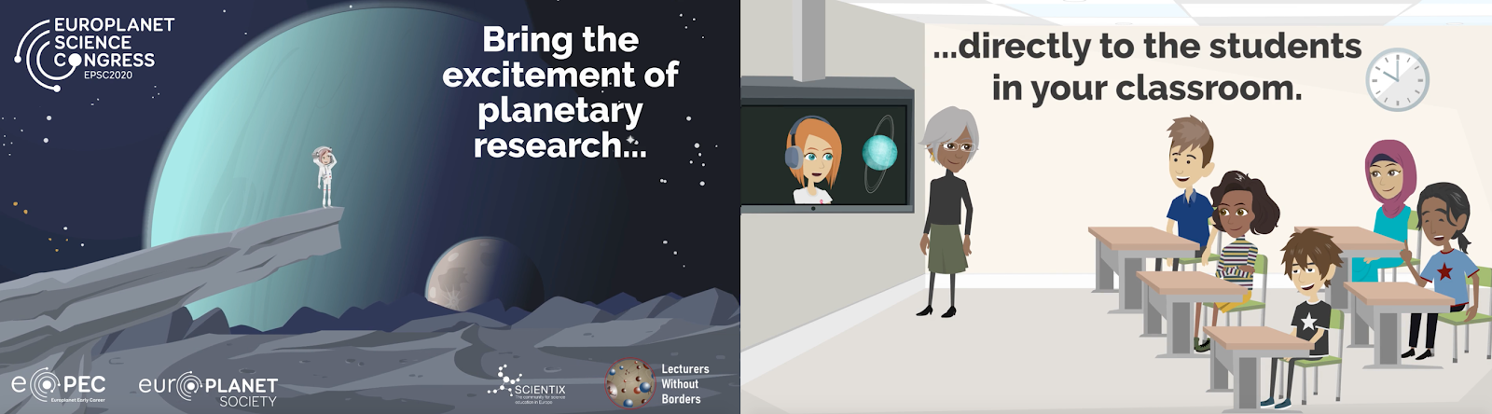
Opening a scientific conference to schools

Slide 9
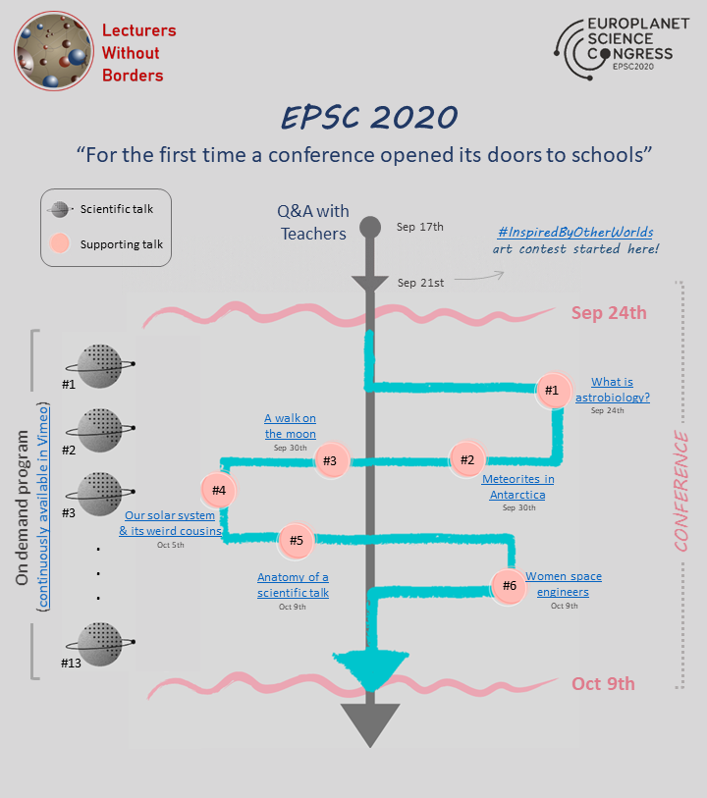

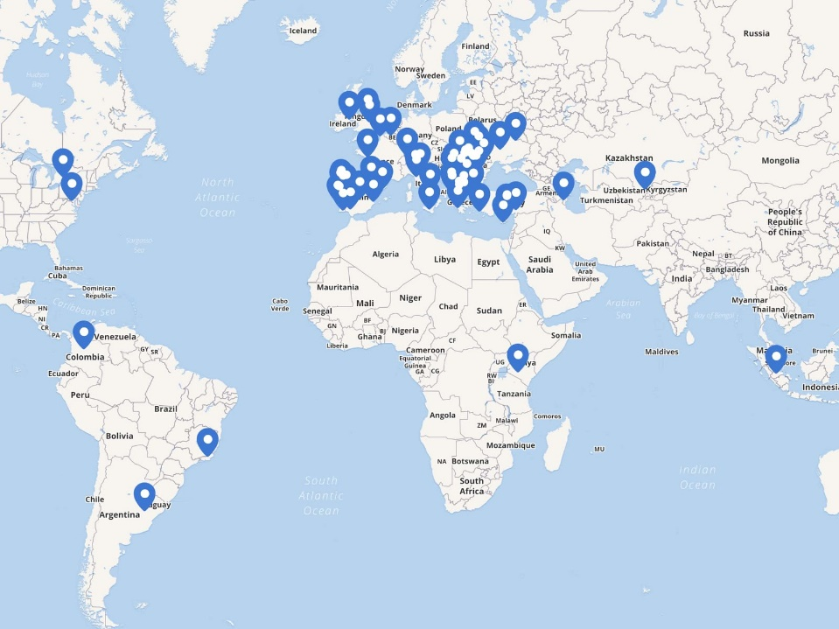
Opening a scientific conference to schools
EPSC 2020 went live for schools!
114 registered schools

Slide 10
Opening a scientific conference to schools
EPSC 2020 went live for schools!
1.
We asked the speakers of EPSC 2020 to agree to make their talks available to the general public.
We curated the material, created plain-language summaries for the videos and published them.
We recuited scientists that would be willing to give supporting talks for kids.
We organized a Q&A meeting with teachers and sent them handbooks with information.
2.
3.
4.

Slide 11
Opening a scientific conference to schools
EPSC 2020 went live for schools!
1.
We asked the speakers of EPSC 2020 to agree to make their talks available to the general public.
We curated the material, created plain-language summaries for the videos and published them.
We recuited scientists that would be willing to give supporting talks for kids.
We organized a Q&A meeting with teachers and sent them handbooks with information.
2.
3.
4.

Slide 12
Opening a scientific conference to schools
EPSC 2020 went live for schools!
1.
We asked the speakers of EPSC 2020 to agree to make their talks available to the general public.
We curated the material, created plain-language summaries for the videos and published them.
We recruited scientists that would be willing to give supporting talks for kids.
We organized a Q&A meeting with teachers and sent them handbooks with information.
2.
3.
4.

Slide 13
Opening a scientific conference to schools
EPSC 2020 went live for schools!
1.
We asked the speakers of EPSC 2020 to agree to make their talks available to the general public.
We curated the material, created plain-language summaries for the videos and published them.
We recruited scientists that would be willing to give supporting talks for kids.
We organized a Q&A meeting with teachers and sent them handbooks with information.
2.
3.
4.

Slide 14
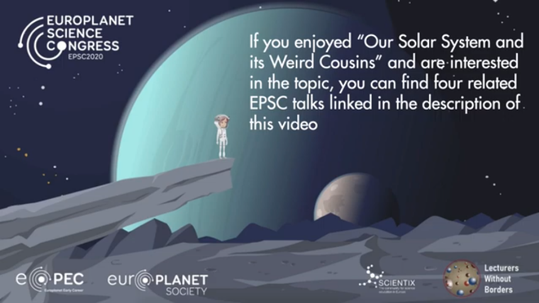


Opening a scientific conference to schools
EPSC 2020 went live for schools!
We organized 6 supporting talks on topics of planetary sciences, with active participation of 43 schools in them.
Supporting talks in our channel
Subset of the conference talks
Create coherence in the material and make it easier to understand and to use in the classroom

Slide 15
Opening a scientific conference to schools
EPSC 2020 went live for schools!
Supporting talk on “The anatomy of a scientific talk” + Q&A with the speaker of one of the conference talks (voted by the schools).
Slack channel continuously available for questions from schools, answered personally by scientists in EPEC
Students participated in an art contest inspired by the talks

Slide 16
Ready to do it again!
Thank you for your attention
Eugenia Covernton - 23/04/2020

